Slide 1


Mapping the landscape… views of professionals from the BRIGHTLIGHT international Delphi survey and beyond
Faith Gibson
Workstream 1 Lead
@bR1GhTLiGhT
#BLTYAC2017

Slide 2
Young people longitudinal survey
Carer data
Health economics data
Multi-site case study
Patient involvement data
NHS Registry Data
Health professional data
Notes:
Where the case study work sits within the overall brightlight programme of research – this may have been introduced by Jeremy or Rachel so should I still have this? Makes it clear which bit of work I undertook and am presenting….?

Slide 3
WORKSTREAM 1
To provide a description of specialist cancer care:
  Explore the culture of care through non-participant observation, interviews and documents analysis
  Identify the specialist competencies and added value of specialist health professionals through a Delphi survey
  Validate a bespoke scale to categorise 3 levels of care received by young people with cancer (‘TYA Cancer Specialism Scale’)

Slide 4
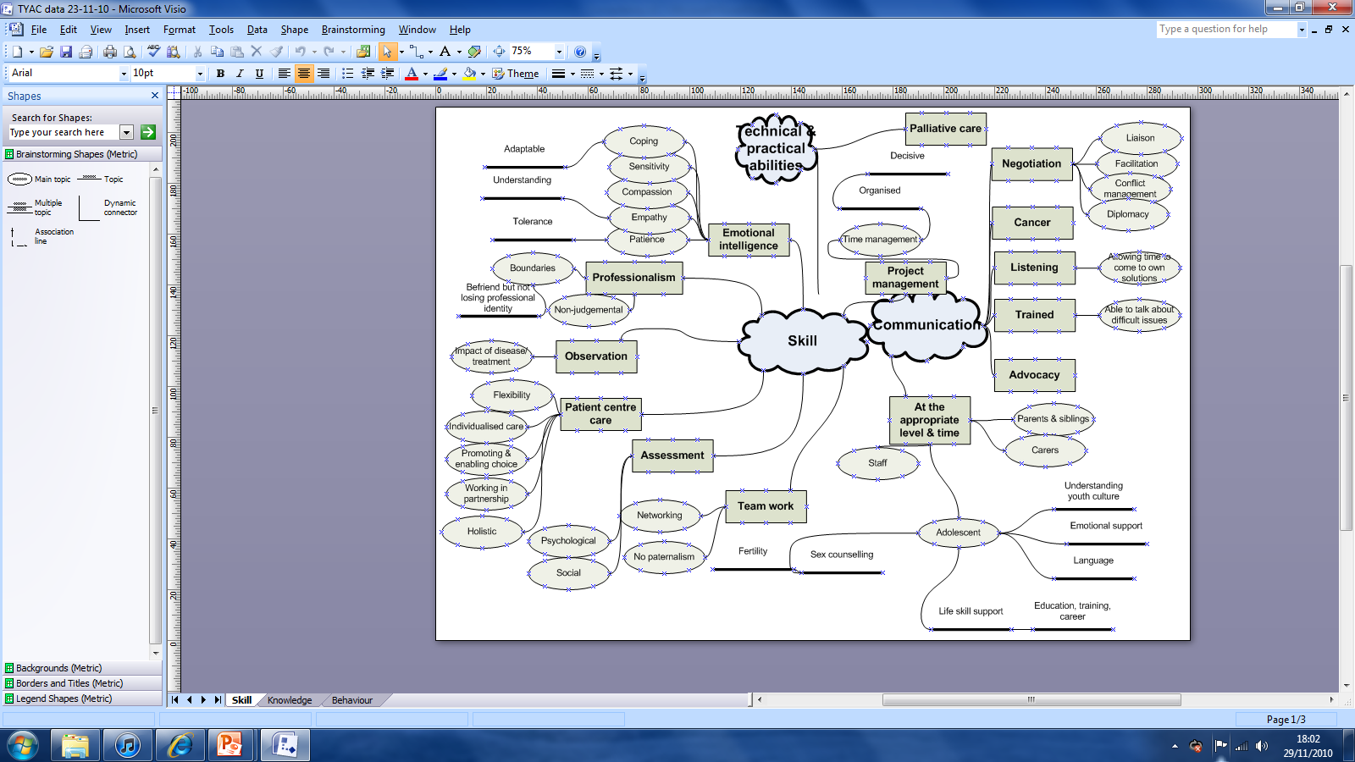
Where did we start?

Slide 5
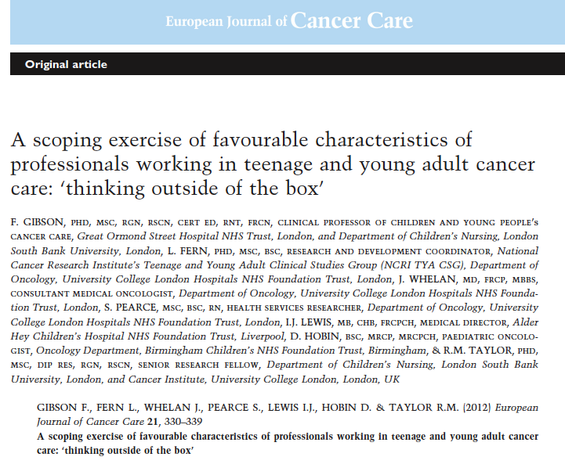
We published the UK perspective………

Slide 6

Since then…………..

Slide 7
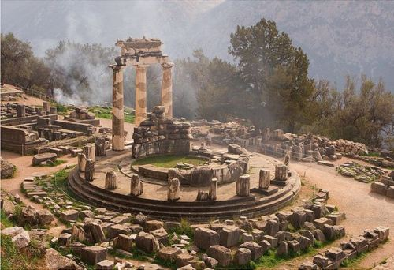
Needed to do further work, we used a modified Delphi survey
To provide international consensus on the competencies required by healthcare professionals to provide specialist care for young people with cancer:
  Skills
  Knowledge
  Attitudes
  Communication

Slide 8
What did we do?
Young person’s workshop, n = 26
Professional workshop, n = 80
Qualitative data analysis
Invite to professional cancer organisations
Personal invite through published emails
Round 1 questionnaire
87 questions score on 9-point scale
Round 1
n = 179
Mean and absolute median of the mean
Qualitative content analysis
Round 1 valid responses
n = 158 (88%)
Round 2 questionnaire
15 additional questions
Identify the most important competencies
Round 2
n = 159
Round 2 valid responses
n = 136 (86%)

Slide 9
Who responded?
Percentage

Slide 10
Where were they from?
Percentage

Slide 11
What did they tell us in Round 1?
Communication Statements
Ability to…
ACT AS AN ADVOCATE FOR YOUNG PEOPLE
Tell young people about all aspects of their disease
Liaise with other professionals on young people’s behalf
Facilitate communication between young people
Resolve conflicts between young people
Resolve conflicts between young people and health professionals
RESOLVE CONFLICTS BETWEEN YOUNG PEOPLE AND THEIR FAMILIES
Listen to young people’s concerns
Talk about difficult issues
ACT AS A BRIDGE BETWEEN YOUNG PEOPLE AND THEIR PARENTS
Allow young people time to come to their own solutions
FACILITATE CARE BETWEEN DIFFERENT ORGANISATIONS/AGENCIES
Provide emotional support young people
Provide bereavement support when peers pass away
Speak to young people in terms that is familiar to them while retaining a professional boundary
TALK TO YOUNG PEOPLE ABOUT SEXUAL ISSUES
Provide life skills support
Discuss the impact of disease on aspirations
Provide career, education or training advice
Items were rated on a 9-point Likert scale from ‘strongly agree’ to ‘strongly disagree’. A median ≥7 indicated high agreement, majority in range of 7-9.

Slide 12
Differences emerged in Round 1
Statement | Doctor n = 62 | Nurse n = 55 | Other professional n = 38
S16. PROVIDE HOLISTIC CARE | 49 (79) | 55 (100) | 28 (74)
S18. Be flexible in how care is delivered | 53 (86) | 54 (98) | 35 (92)
K1. CULTURAL ISSUES | 43 (69) | 50 (91) | 25 (66)
K3. Developmental issues related to emerging adulthood | 53 (86) | 54 (98) | 35 (92)
K4. Family issues | 56 (90) | 53 (96) | 29 (76)
K7. Environmental issues impacting young people’s health | 38 (61) | 46 (84) | 21 (55)
K9. The importance of restoring normality | 54 (87) | 55 (100) | 35 (92)
K11. Know the ethical issues related to caring for young people with cancer | 55 (89) | 54 (98) | 31 (82)
C1. Act as an advocate for young people | 43 (69) | 53 (96) | 26 (68)
C2. Tell young people about all aspects of their disease | 59 (95) | 49 (89) | 20 (53)
C4. FACILITATE COMMUNICATION BETWEEN YOUNG PEOPLE | 39 (63) | 53 (96) | 24 (63)
C5. Resolve conflicts between young people | 29 (47) | 45 (82) | 15 (40)
C7. Resolve conflicts between young people and their families | 43 (69) | 50 (91) | 27 (71)
C11. Allow young people time to come to their own solutions | 48 (77) | 53 (96) | 32 (84)
C13. Provide emotional support young people | 53 (86) | 54 (98) | 35 (92)
C14. Provide bereavement support when peers pass away | 49 (79) | 53 (96) | 29 (76)
A14. Be motivated | 56 (90) | 52 (96) | 30 (79)
A24. Able to have a work-life balance | 42 (68) | 50 (91) | 29 (76)

Slide 13
Round 1: Focusing on 3 statements where there were differences
K1 Cultural issues
Doctor=43(69%)
Nurse=50(91%)
C4 Facilitate communication between young people
Doctor=39(63%)
Nurse=53(96%)
S16 Provide holistic care
Doctor=49(79%)
0ther=28(74%)
Other=25(66%)
0ther=24(63%)
Nurse=55(100%)

Slide 14
What extra did we ask in Round 2?
Statement
Skills
S27 Able to consent patients to clinical research and trials
S28 Able to address young people's concerns on spirituality appropriately
S29 Able to discuss sensitive subjects e.g. sexual issues, fertility
Knowledge
K19 Know about current therapies
K20 Know about the availability of clinical trials for this age group
K21 Know about new drugs
K22 Know about normal physical and psychological development
K23 Know about impact of cancer on psychological development
K24 Know about side-effects of treatment and how this might be different to those experienced by children or older adults
K25 Know about paediatric oncology
K26 Know about adult oncology
K27 Know about fertility preservation
K28 Know about normal adolescent physiology
K29 Know about the availability of psychosocial research for this age group
Attitudes
A25 Ability to use humour appropriately when interacting with young people

Slide 15
Differences emerged in Round 2
Statement | Doctor n = 50 | Nurse n = 50 | Other profession n =36
S27. ABLE TO CONSENT PATIENTS TO CLINICAL RESEARCH AND TRIALS | 40 (80) | 27 (54) | 16 (44)
S28. ABLE TO ADDRESS YOUNG PEOPLE'S CONCERNS ON SPIRITUALITY APPROPRIATELY | 23 (46) | 35 (70) | 18 (50)
K19. Know about current therapies | 50 (100) | 43 (86) | 30 (83)
K20. Know about the availability of clinical trials for this age group | 50 (100) | 38 (79) | 26 (72)
K21. Know about new drugs | 48 (96) | 41 (82) | 23 (64)
K24. Know about side-effects of treatment and how this might be different to those experienced by children or older adults | 48 (96) | 50 (100) | 32 (89)
A25. Ability to use humour appropriately when interacting with young people | 44 (88) | 47 (94) | 25 (94)

Slide 16
Round 2: Focusing on 2 statements where there were differences
S27 Able to consent patients to clinical research and trials
Doctor=40(80%)
Nurse=27(54%)
S28 Able to address young people’s concerns on spirituality appropriately
Doctor=23(46%)
Other=16(44%)
Nurse=35(70%)
0ther=18(50%)

Slide 17
Top 2 areas of competence
Skill
Identify the impact of disease on young people’s life
Have excellent clinical skills
Knowledge
Know about side-effects of treatment and how this might be different to those experienced by children or older adults
Know how to provide age appropriate care
Attitude
Honesty
Communication
Friendly and approachable
Listen to young people’s concerns
Talk about difficult issues

Slide 18
What did we learn…..
There was a high level of agreement/consensus for Round 1, in all items in all areas (skills, knowledge, attitudes, communication)
  we might have anticipated this.
Some variation existed according to profession
  this highlights important distinctions to explore further in pursuit of effective multi-disciplinary team working.

Slide 19
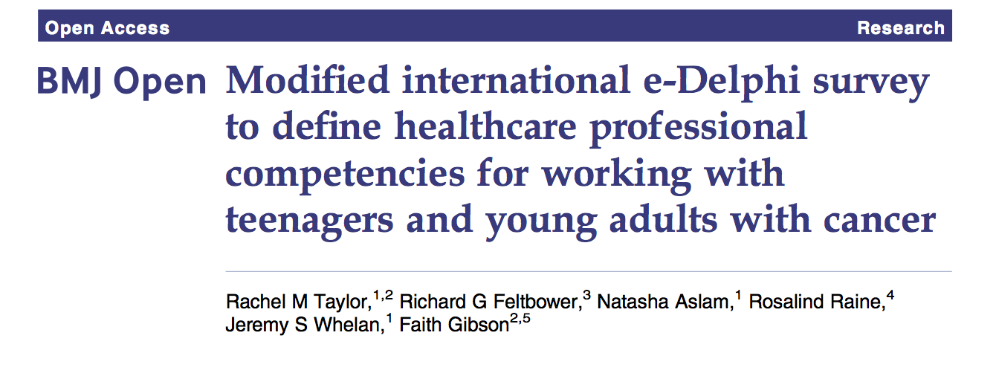
We published the international perspective

Slide 20
If we draw upon all available resources, collaborate within and across the multi-professional team and share
Informs workforce planning
Important when designing a service
Offers direction to national and international education and training

Slide 21
Possible places to impact….
Informs workforce planning, new and established teams
Directs national and international education and training
Used as a benchmark against which standards can be assessed
Inform competency-based assessment of performance
Details composition of the clinical team, particularly helpful for new teams

Slide 22


In summary….
Having the 'right people for the job' is essential to ensure young people receive the care that, as individuals, they need to navigate treatment and care that helps them the most.
  Descriptions of specialist competencies are now available to inform recruitment and workforce planning, peer review, and benchmarking exercises.
  Consensus statements on skills, knowledge, attitudes and communication, can now be used with confidence to underpin national and international education and training.
  Clarity around professional roles and responsibilities can be examined and expanded using these competencies.

Slide 23



QUESTIONS
This presentation presents independent research funded by the National Institute for Health Research (NIHR) under its Programme Grants for Applied Research Programme (Grant Reference Number RP-PG-1209-10013). The views expressed are those of the author(s) and not necessarily those of the NHS, the NIHR or the Department of Health.
uclh.brightlight@nhs.net
www.brightlightstudy.com
0741 555 7668
@bR1GhTLiGhT

