Slide 1
BRIGHTLIGHT: from first glow to now – what, why and how
Professor Jeremy Whelan
BRIGHTLIGHT Chief Investigator & Workstream 2 Lead
@bR1GhTLiGhT
#BLTYAC2017

Slide 2
Why are young people ‘special’?
Cancer in TYA is rare, <1% of all new cancer diagnoses in England
Cancer is the leading cause of death in young people aged 15 – 24 years in the UK
Spectrum of cancer types distinct from children and older adults
Outcomes are inferior to those in children or older adults
A cancer diagnosis superimposed on time of great physical, emotional and social growth

Slide 3
Development of TYA services
Local initiatives driven by pioneers
Early support of charities
First teenage cancer unit opening in 1990
Daily Mail says units ‘improve survival’
Advocacy for inclusion in national cancer agenda

Slide 4
How were services changed to improve this?
2005 NICE Improving Outcomes Guidance
  <19 years referred to a Principal Treatment Centre (PTC)
  19 – 24 years offered a choice and ‘unhindered access to age-appropriate care’
October 2010 – March 2011
  60 – 70% in TYA, children’s or main adult oncology units
  30 – 40% in other hospitals

Slide 5
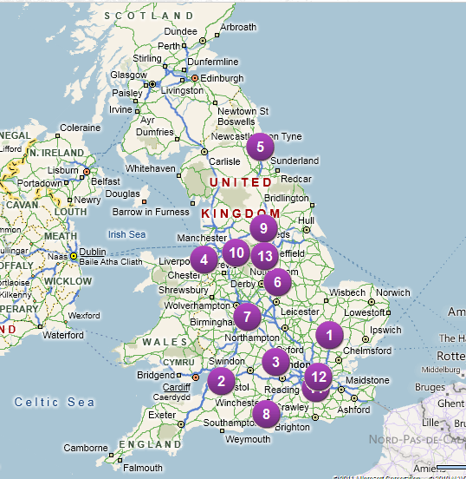
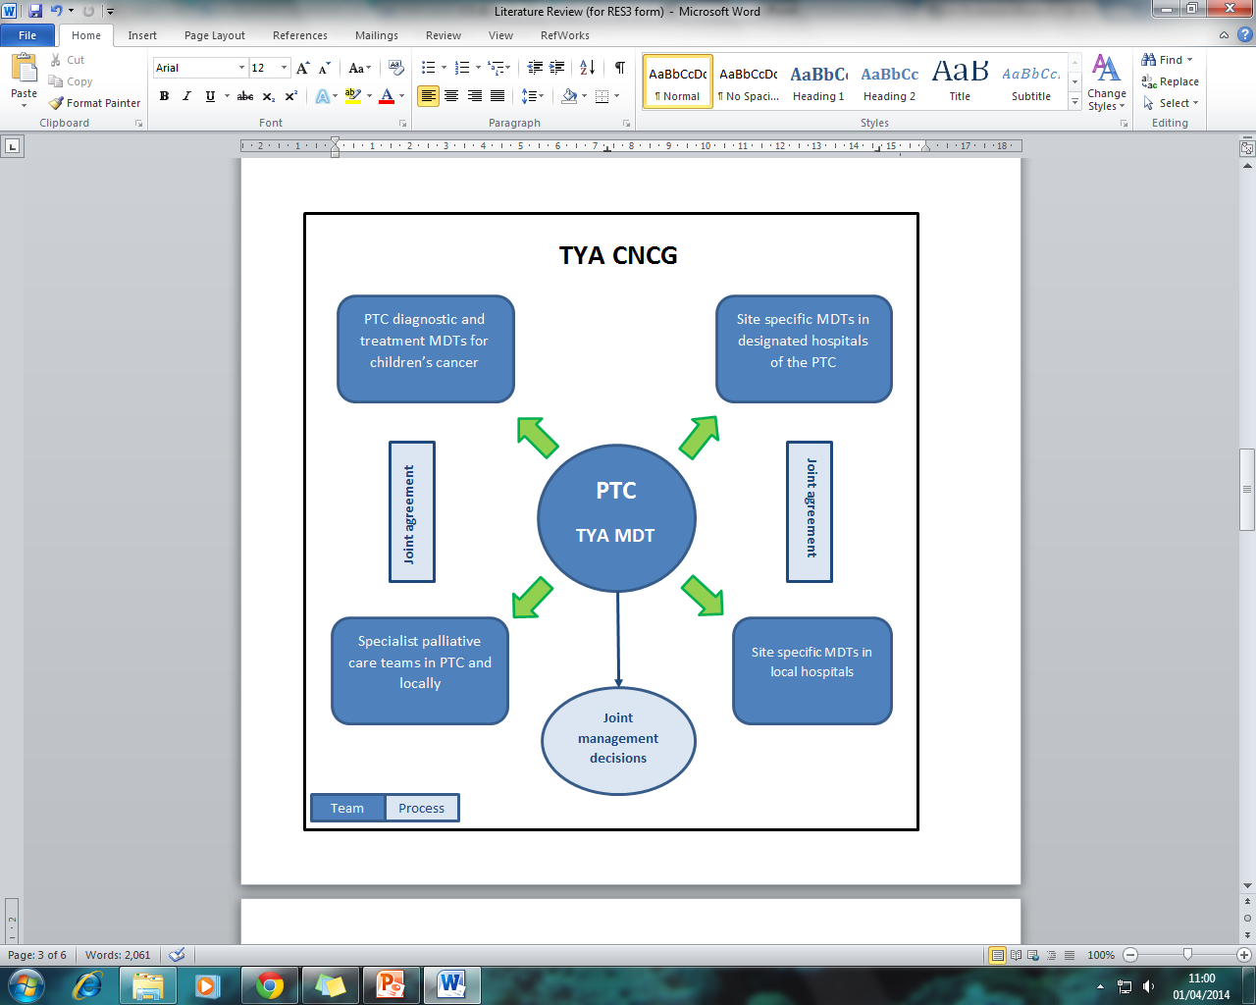
TYA PTC & designated hospitals

Slide 6

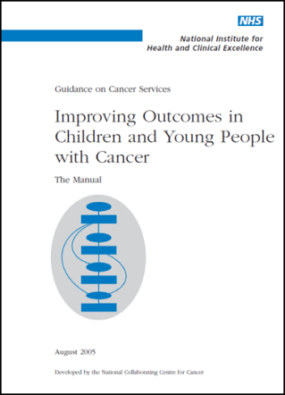
What is age appropriate specialist care?
Which are the most important elements of a TYA service?
What outcomes are improved by this service?
How much does this cost the young people, their families and the NHS?

Slide 7
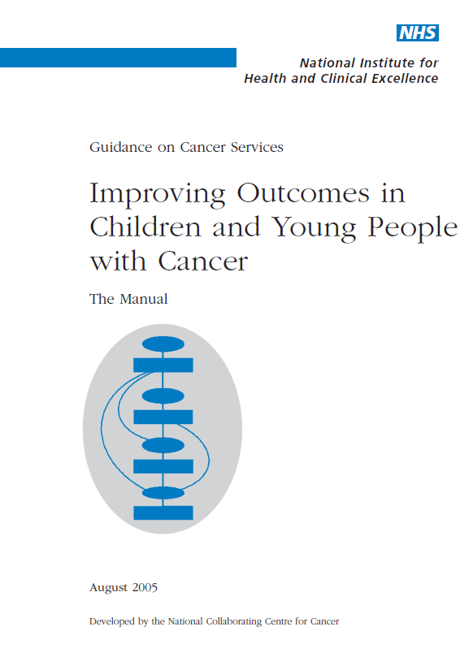


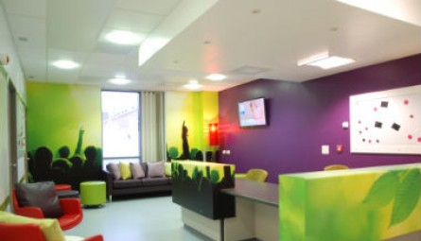

Do specialist cancer services for teenagers and young adults add value?

Slide 8
Challenges: how and what to measure
Methodology?
  Ideally randomised controlled trial, BUT
    Services are already in place
    Ethically and practically difficult to randomise to specialist care vs. not
    Variation in services across country
What sample?
  Manage heterogeneity
  National cohort, BUT
    How do you identify ALL young people?
    How do you recruit ALL young people?
What outcomes?

Slide 9

Phase 1: Essence of Care
Feasibility study funded by Teenage Cancer Trust

Slide 10
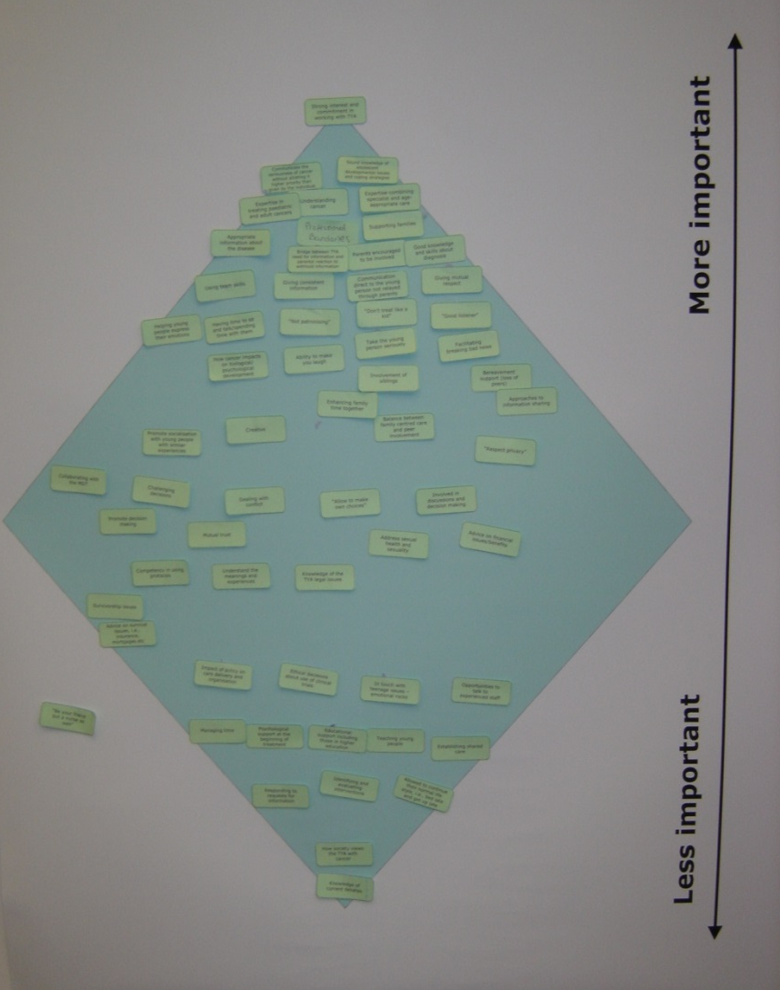
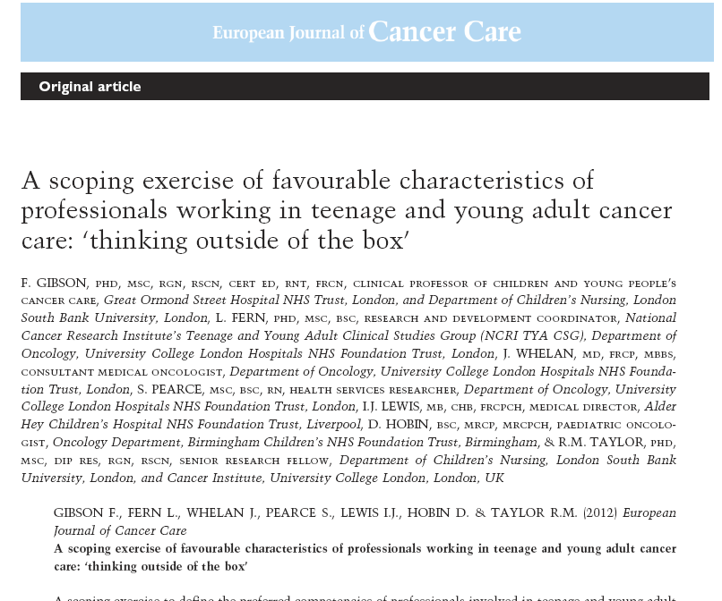
WHO is providing care?

Slide 11
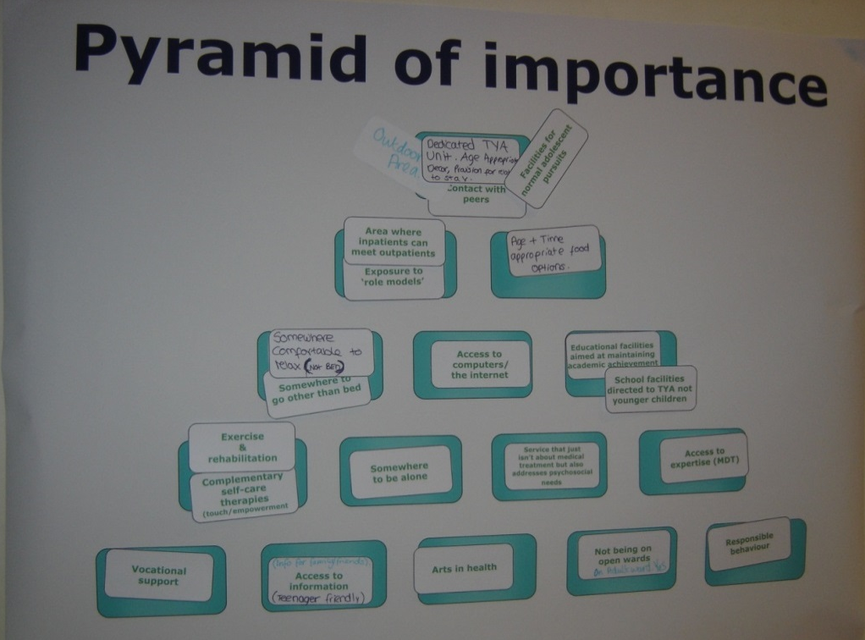
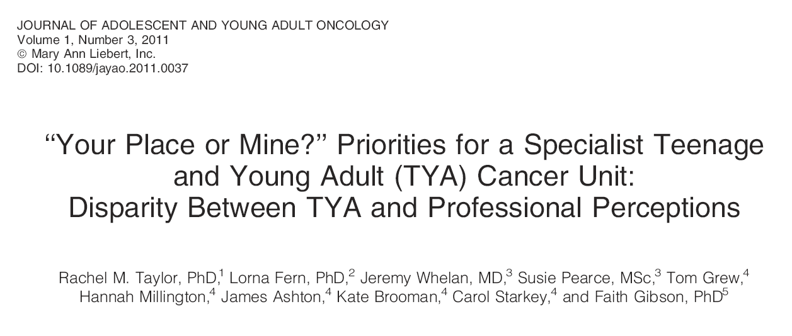
WHERE is care provided?

Slide 12
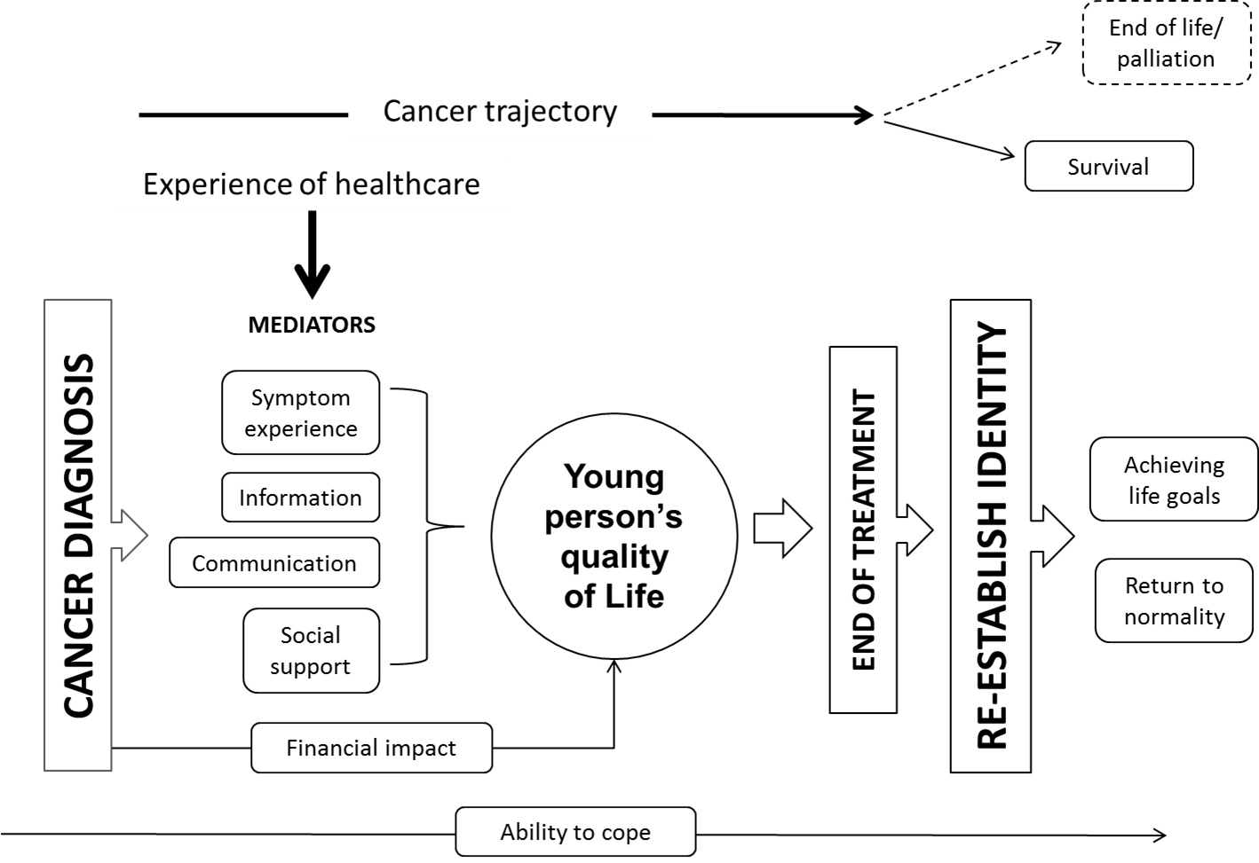
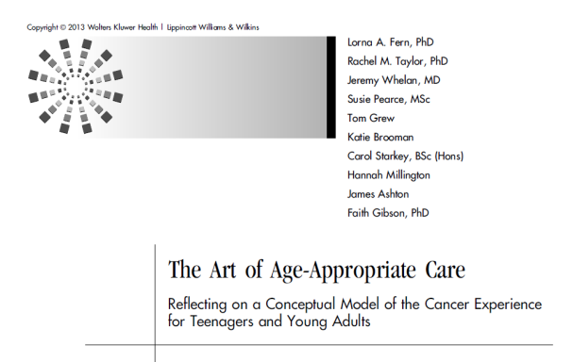
WHAT are young people’s experiences of care?

Slide 13
WHO
WHERE
WHAT
NIHR Programme for Applied Health Research grant

Slide 14
Aims of BRIGHTLIGHT
Workstream 1: What is specialist care?
  Explore the culture of care
  Identify the competencies of specialist professionals
  Develop a bespoke metric to quantify specialist care
Workstream 2: What outcomes are associated with specialist care?
  Impact of specialist care on outcomes, experience and processes of care
  Socio-demographic and geographic inequalities in access to specialist care
Workstream 3: How much does specialist care cost?
  Estimate the cost of care (cost effectiveness and cost benefit)
Workstream 4: What change could result?
  Formulate opportunities for change

Slide 15
Methods
Modified e-Delphi Survey
Workstream 1
Mosaic
Case Study
Secondary analysis of HES data
Workstream 4
Longitudinal cohort study
Workstream 2
Carer survey
Workstream 3
Health economic analysis
Patient and Public Involvement

Slide 16


Longitudinal cohort study
Workstream 2
Carer survey
Specialist care
Specialist care
Quality of life
Satisfaction with care
Experience of illness
Anxiety and depression
Disease and care process parameters

Slide 17
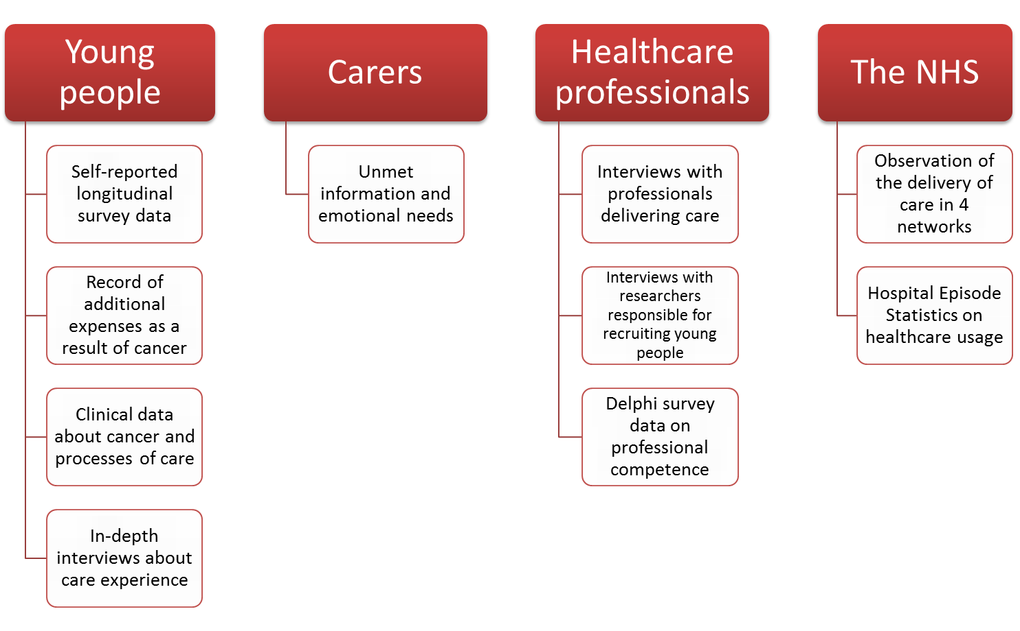
BRIGHTLIGHT Data Bank
Young people longitudinal survey
Health professional data
Health economics data
Multi-site case study
Carer data
NHS registry data
Patient involvement data

Slide 18
What we will be sharing with you…
What happens when attempting to recruit young people with cancer to a national research study
Why young people are essential for co-production, co-creation and co-design
The skills, attitude and knowledge of the TYA MDT
Young adults’ experience of care at the end of life
A description of age appropriate care
The impact of cancer on carers

Slide 19

Do specialist cancer services for teenagers and young adults add value?

Slide 20



Slide 21

A Changing World
Cancer Networks
Research Networks
Research Regulation
Data Protection
UK Data
Commissioning

Slide 22


More constant..

Slide 23
What has made BRIGHTLIGHT valuable?
Involvement of young people
Involvement of all PTCs and wider TYA community
Challenges … solutions
Implications for future care
Extending research in TYA care

Slide 24
Implications for practice
Based on current evidence:
  Product for workforce planning/training
  Evidence to expand on the 5As recruitment model (Fern et al. Lancet Oncol 2014; 15: e341–50)
Based on future evidence
  Evidence based support for carers
  Direction for commissioners on specialist care
  Evidence for informed choice
  Transferability to young people with other long-term conditions

Slide 25
Implications for policy
NICE Surveillance Team, July 2014
‘The improving outcomes for children and young people with cancer service guidance should not be considered for an update at this time. The guideline should remain on the active list and be considered in light of results emerging from existing trials such as the BRIGHTLIGHT study.’
Achieving world-class cancer outcomes: A strategy for England 2015-2020 (Independent Task Force)
#43: Establish clear criteria for designation and de-designation of treatment centres for TYA patients
#45: …consider ways in which access to clinical trials for teenagers and young adults with cancer could be significantly increased

Slide 26
Implications for research
Companion studies
  When Cure is Not Likely (Marie Curie)
Current
  S-PROM (SUK/BCRT)
  RELEASE_ME (NIHR HS&DR)
  Extended cost analysis (NIHR PhD fellowship)
  REFER_ME (tbc - NIHR PGfAR)
Future
  RECRUIT_ME
  James Lind Alliance
    Secondary data analysis
  Inform intervention development

Slide 27



QUESTIONS
This presentation presents independent research funded by the National Institute for Health Research (NIHR) under its Programme Grants for Applied Research Programme (Grant Reference Number RP-PG-1209-10013). The views expressed are those of the author(s) and not necessarily those of the NHS, the NIHR or the Department of Health.
uclh.brightlight@nhs.net
www.brightlightstudy.com
0741 555 7668
@bR1GhTLiGhT

