Slide 1
Participatory research: using board games to guide secondary analysis of big data
Rachel Taylor, Ana Martins, Sarah Lea, Jeremy Whelan, Lorna Fern
University College London Hospitals NHS Foundation Trust

Slide 2
Introduction
Teenagers and young adults with cancer have poorer outcomes than children and older adults
  Improving Outcome Guidance for Children and Young People
Reconfigured services
  15-18 years refer to TYA Principal Treatment Centre
  19-24 years ‘unhindered access’ to specialist care

Slide 3



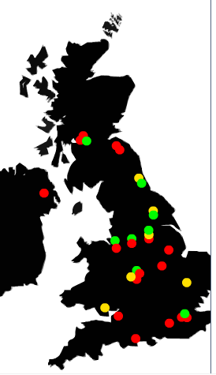

Do specialist cancer services for teenagers and young adults add value?

Slide 4
What is BRIGHTLIGHT?
National evaluation of cancer services for TYA in England
Programme of work comprising 3 workstreams
  Workstream 1: environment of care and competence of professionals delivering care
  Workstream 2: young people and carers experience of care; impact of care on outcome
  Workstream 3: cost effectiveness and benefit

Slide 5
What makes BRIGHTLIGHT unusual?
Young people involvement and engagement from the onset
  NCRI TYA CSG CCG
Developed with young people, for young people to make results meaningful to young people
Young Advisory Panel (YAP)

Slide 6
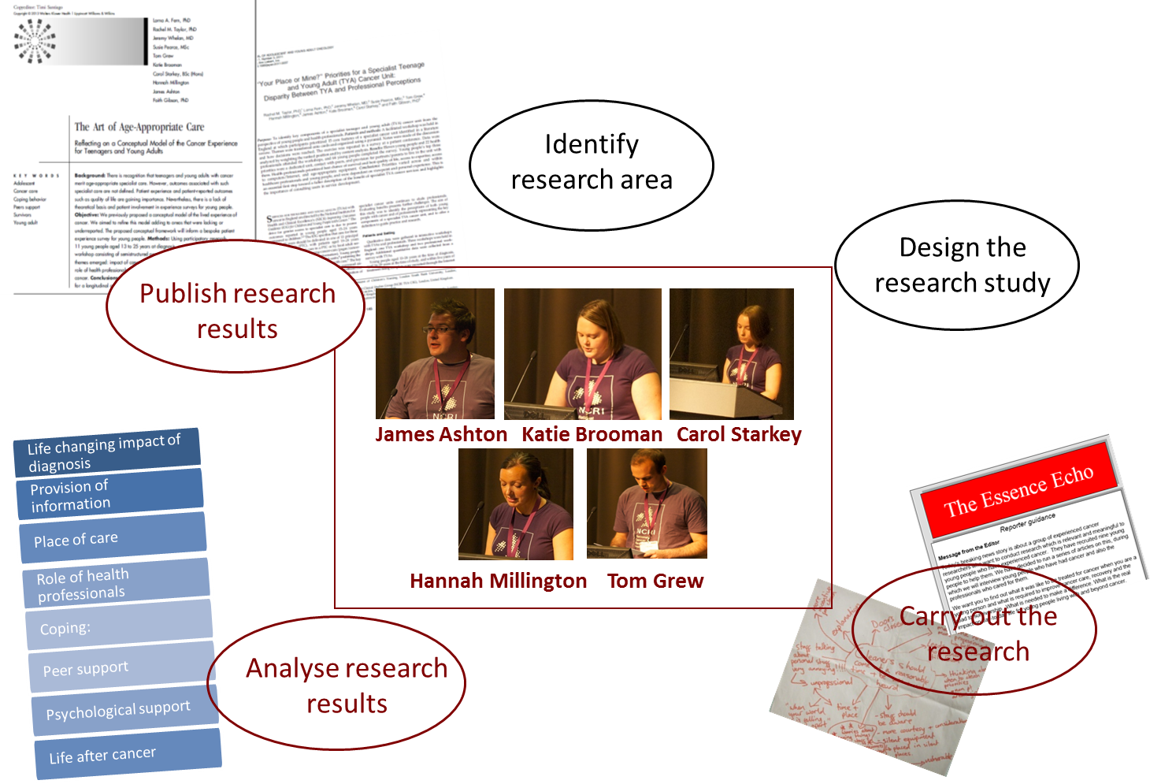
CCG & protocol development

Slide 7
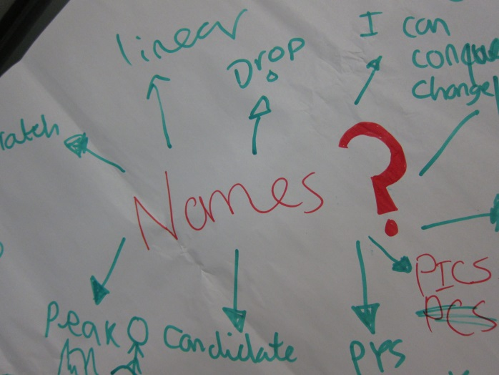
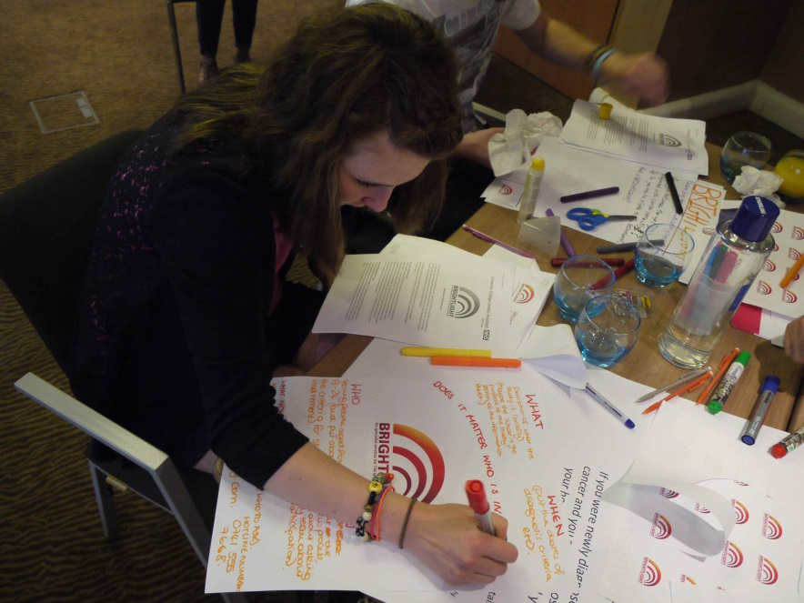
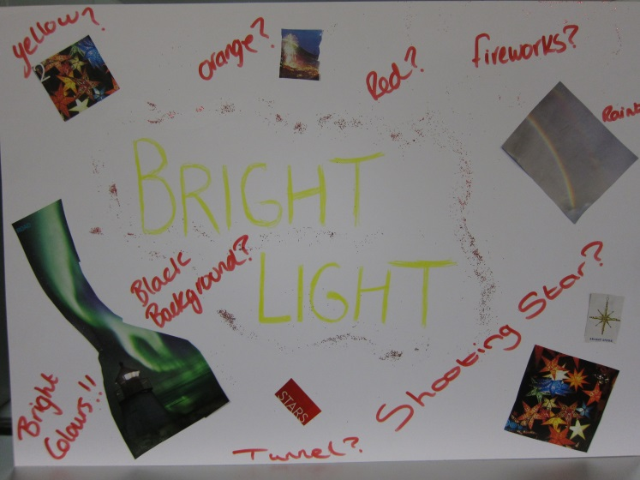
Branding BRIGHTLIGHT

Slide 8
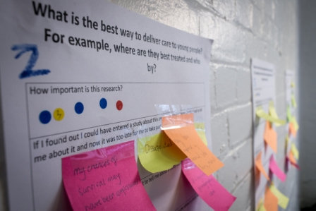
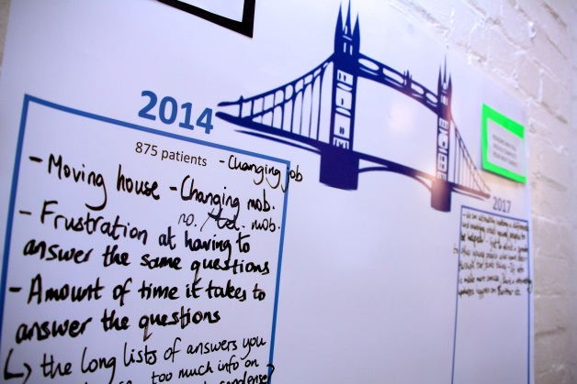
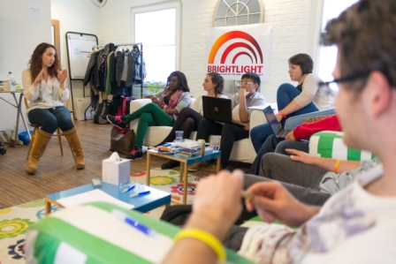
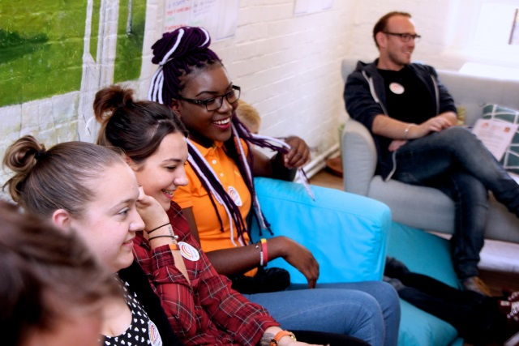
YAP & study management
Recruitment
Retention

Slide 9

YAP & dissemination

Slide 10
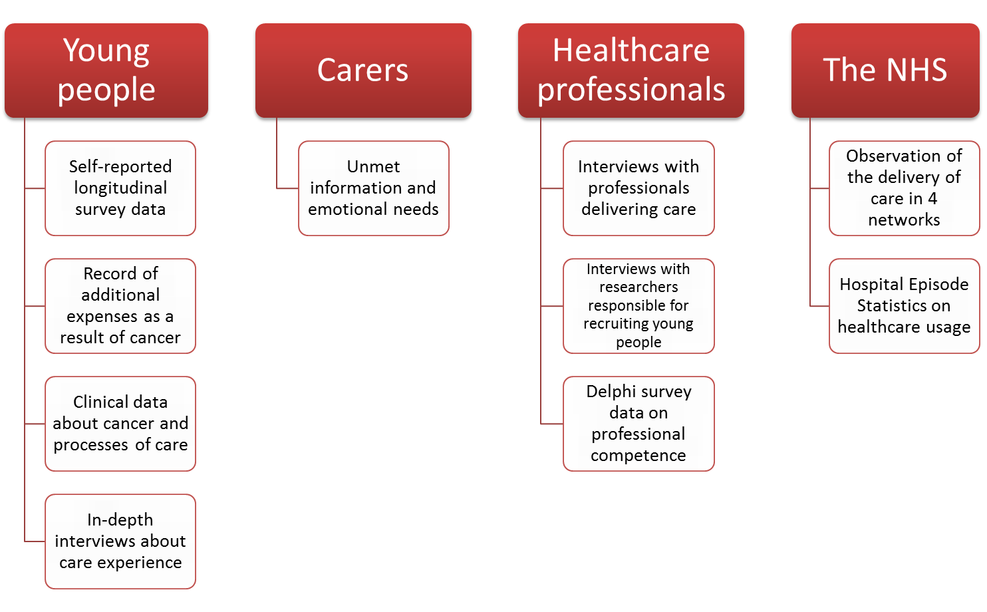
BRIGHTLIGHT Data Bank

Slide 11
Aim
Identify what young people thought was important to investigate further in secondary data analysis

Slide 12
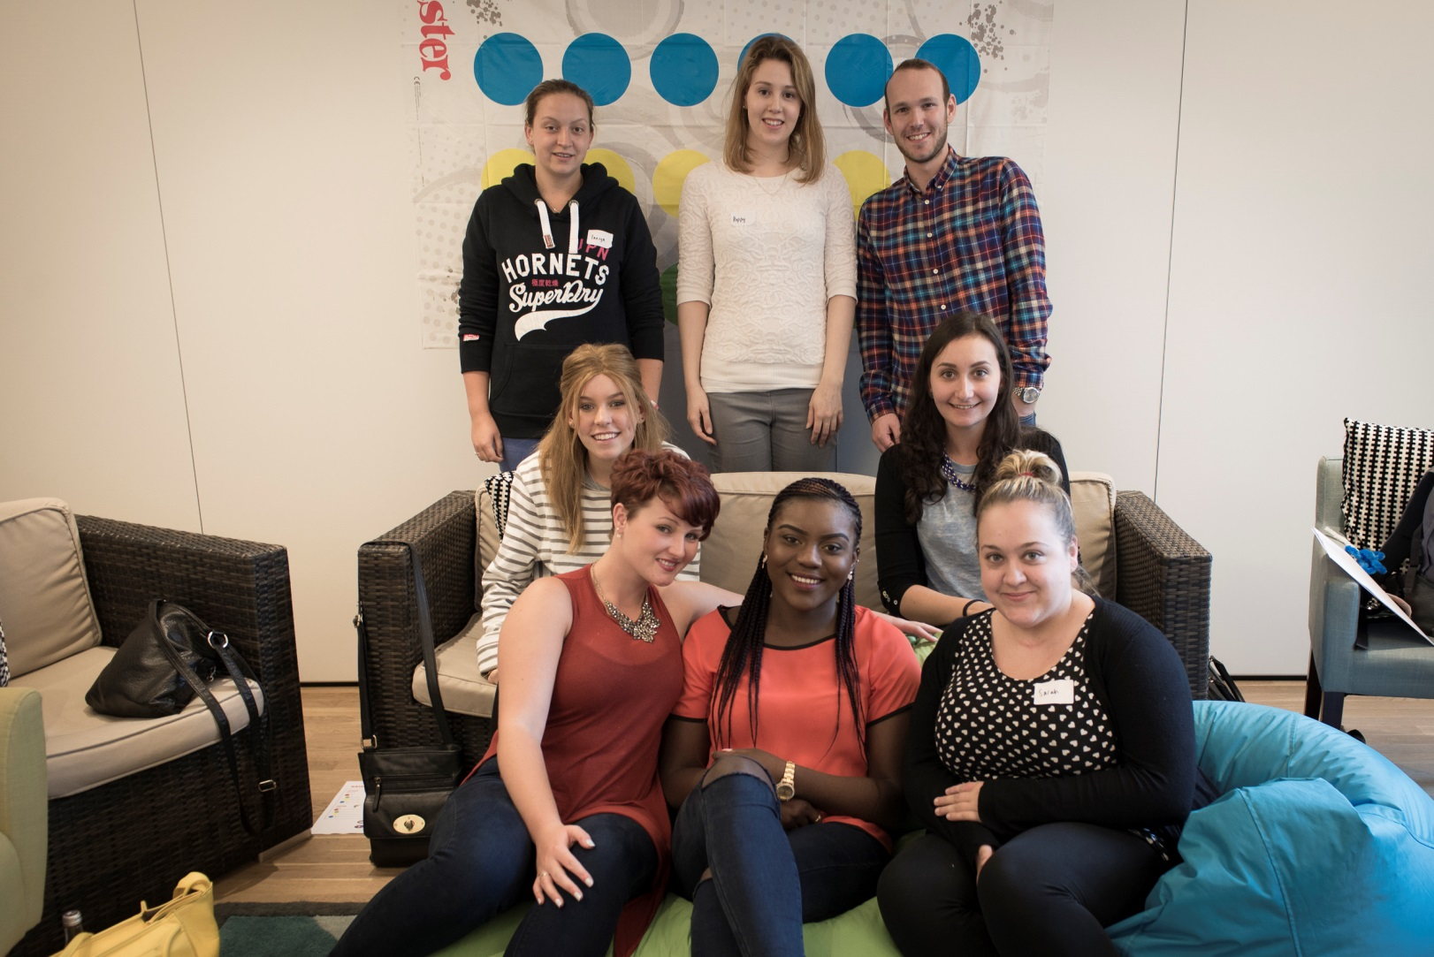
Participants

Slide 13
Methods
Two teams: BRIGHT Team & LIGHT Team
Two members from each team were on the mat at any one time; the other members spun the wheel
Teams made alternate spins until all 4 players had made a move
The links between each teams moves were recorded
Each team then discussed how they thought the two domains were linked

Slide 14
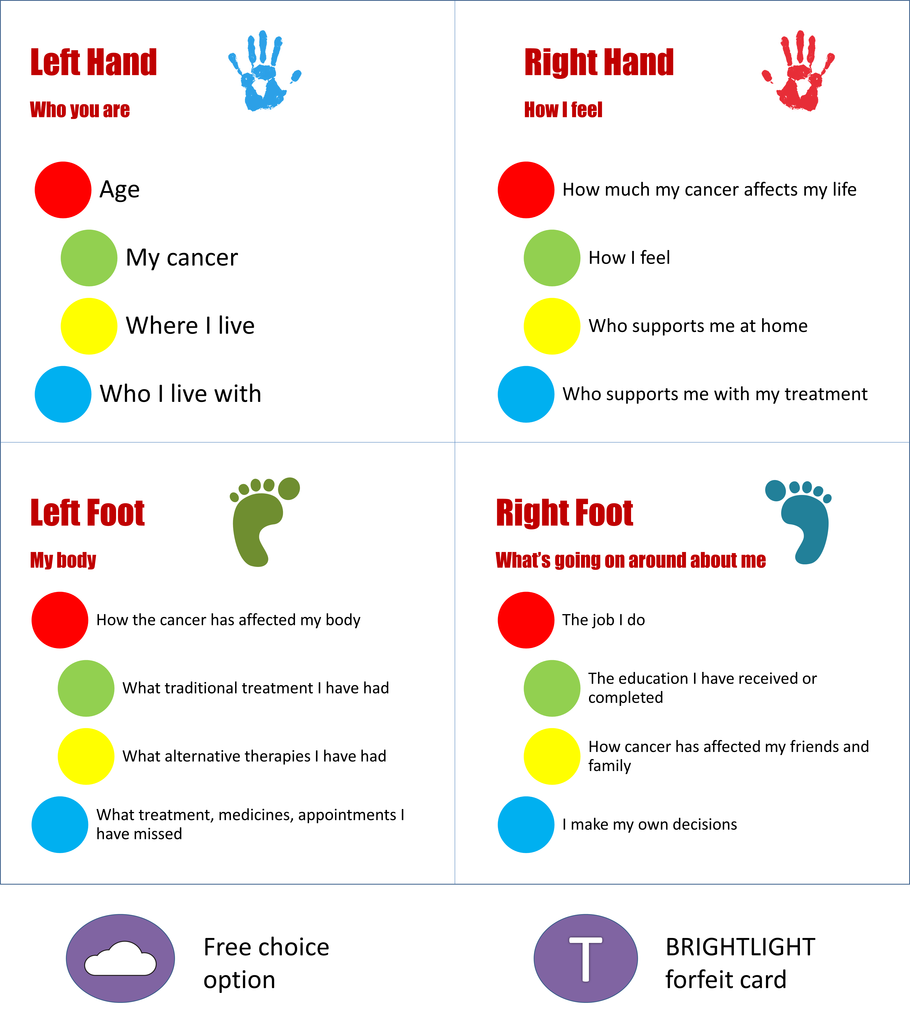

Slide 15
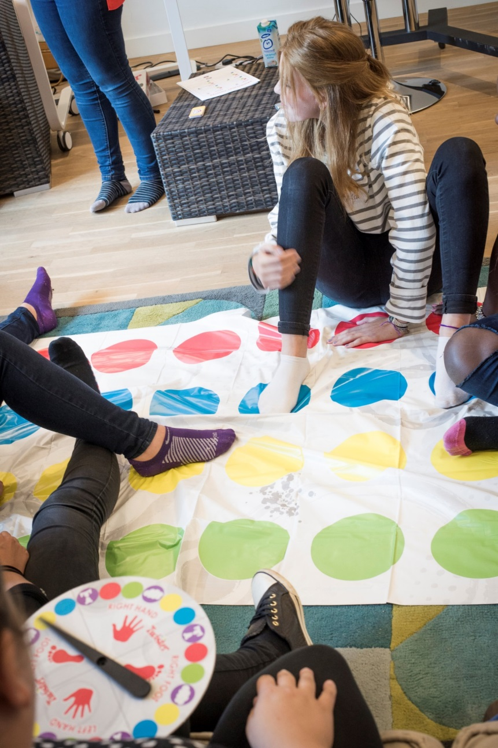
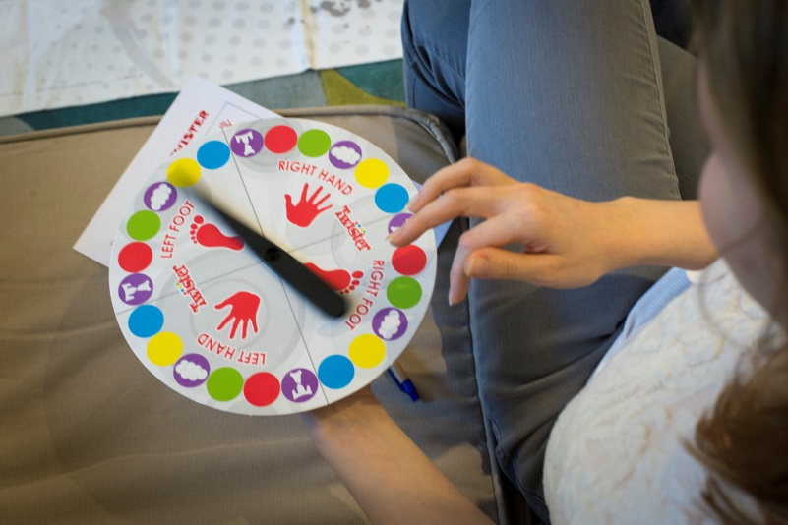
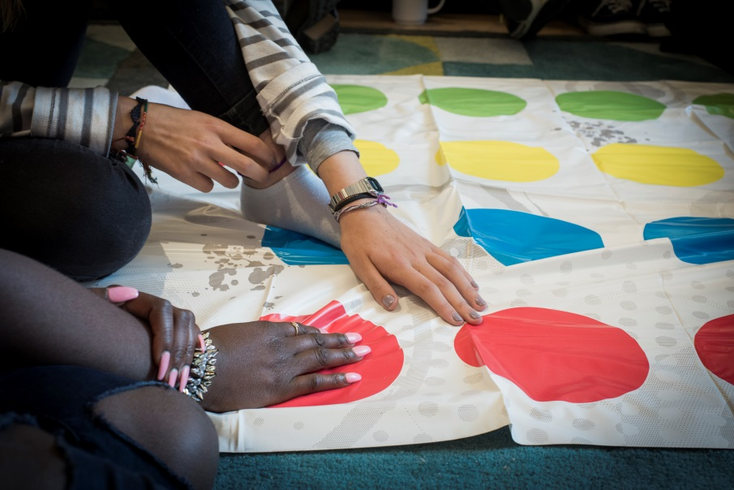

Slide 16
Results
Thirty-six links were discussed
  21 hypotheses or research questions
Circulated to the YAP to individually vote for their top 3
Is the impact of cancer affected by how much support you get from people in similar situations?
How I feel about my body after a cancer diagnosis affects my ability to form new relationships?
=Am I less likely to be involved in decision-making if I am younger?
=How much information I received from my treatment team affects how I feel about myself when treatment finishes?

Slide 17
Conclusions
Young people can actively be involved in generating ideas for secondary data analysis if they are given the appropriate tool
  Not necessarily those viewed as important by healthcare professionals
YAPs opinion plus James Lind Alliance priority setting exercise is currently underway
  Secondary data analysis will also be informed by the results of this.

Slide 18
Value of involving young people
“The events get better and better each year. You guys actually take the suggestions on board and improve accordingly :)”
Post workshop feedback

Slide 19
Thank you for your time
This presentation presents independent research funded by the National Institute for Health Research (NIHR) under its Programme Grants for Applied Research Programme (Grant Reference Number RP-PG-1209-10013). The views expressed are those of the author(s) and not necessarily those of the NHS, the NIHR or the Department of Health.
Email: brightlight@uclh.nhs.uk
Website: www.brightlightstudy.com
Phone: 0741 555 7668

